Slide 1
Watch And Rate
Supervisors:
Dr. Reem Bahgat
Dr. Hanaa Bioumy

Slide 2
Team Members
ID | Name | Email
20120076 | Esraa Ahmed | eng.asousa29@gmail.com
20120431 | Noha Magdy Saber | noha.magdy.99@gmail.com
20120152 | Hossam Hesham Abd El Fattah | hosam_azzam2010@yahoo.com
20120476 | Heba Sayed Shamardy | hesashmoel@gmail.com

Slide 3
Outline
Watch and Rate overview
Related work
Sentiment analysis for Watch and Rate
Used tools
“Watch and Rate” Application
Future Work
Conclusion

Slide 4
Brief description
Watch and rate is an application for movie reviews where we get movie rating through sentiment analysis for reviews
Scope this system is mainly a web service that uses a mobile application as a frontend, and a computer or server for backend for movie reviews
Motivation
There aren’t a lot of applications to give us good and right reviews and rating of the movie
We added extra features using “NLP” to help in rating movies giving the sentiment of the review of a user.

Slide 5
Brief description (continued)
Objectives Is to provide an application that anyone interested in movies field. to help them
in deciding whether the movie they want to watch is good enough or not.
Stakeholders
Anyone that interested to know the movie reviews\rate before watching it.
Anyone want to know movie story through it’s reviews.
Movie cast and director who need to know people feedbacks about their movie.

Slide 6
Related Work
We did it based on applications such as:
IMDb application:
https://itunes.apple.com/us/app/imdb-movies-tv/id342792525?mt=8
Rotten tomatoes application:
https://itunes.apple.com/us/app/movies-by-flixster-rotten/id284235722?mt=8
New movies review application:
https://play.google.com/store/apps/details?id=com.altsoldev.newmoviereviews
Common sense media application:
https://play.google.com/store/apps/details?id=com.csm.KidsMedia

Slide 7
Related Work Continued
Extra features
Write comment on/rate review
Specify sentiment of movie features from movie reviews
Recommend movies to users
User score

Slide 8
Different features | Watch & Rate | Other sites | Reason
Share movie | No | Yes | Because app is mainly for rating & movie reviews
Lowest rated movies | No | Yes | User does not need to know least rated movies
Gallery | No | Yes | App core does not need it
Voice search | No | Yes | Future work
Watch list | No | Yes | Future work

Slide 9
Sentiment Analysis
Sentiment analysis (opinion mining) is a type of natural language processing for tracking the mood of the public about a particular product.
Sentiment analysis classification level:
Document level
Sentence level : Used in Watch and Rate
Attribute level

Slide 10
Sentiment analysis continued
Machine Learning approaches:
Supervised learning
Unsupervised learning
Semi supervised
We use sentiment analysis in classifying user reviews into positive and negative reviews. Based on this classification, we give movie rating (system rating) for a certain movie.
Language used in sentiment analysis: English

Slide 11
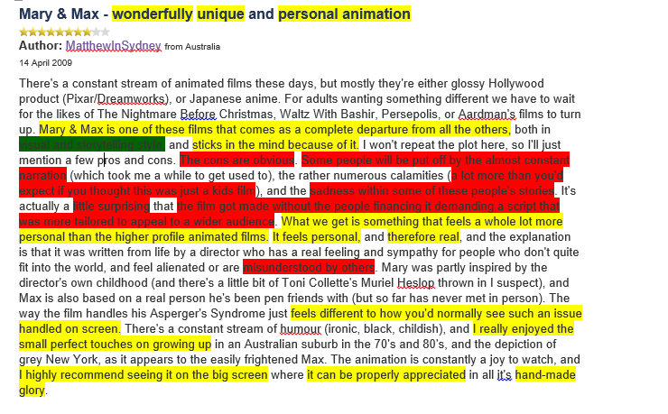
First phase: Annotation
Colors Meaning:
Yellow: Used to annotate positive sentences
Red: Used to annotate negative sentences
Green: Used to annotate movie features appeared in training data

Slide 12
Features
The second phase was to choose which features can be used to classify a sentence and which feature was important to the support vector machine which was in our case WEKA to train and get a good accuracy to generate a model that can predict.

Slide 13
Features
positive_words: number of positive words in the sentence using sentiword. a word is considered positive if its positive weight is greater than negative weight.
negative_words: number of negative words in the sentence using sentiword. a word is considered negative if its positive weight is less than negative weight.
positive_score: the summation of positive weights of all words in a sentence
negative_score: the summation of negative weights of all words in a sentence
strongPositive: number of positive words that have positive weight greater than 0.5 or a normal positive word but preceded by an intensifier.
strongNegative: number of negative words that have negative weight greater than 0.5 or a normal negative word but preceded by an intensifier.
adj_words: number of adjective words in the sentence using Stanford POS tagger.
adv_words: number of adverb words in the sentence using Stanford POS tagger.
subjective_words: any word in the sentence that has emotion positive or negative – Used sentiword -
neutral_words: any word in the sentence that doesn’t have any emotion in it.
Class: negative class or positive class

Slide 14
WEKA Trials
To get an accuracy, features are chosen and tried till 94% accuracy is reached. WEKA tool is used to classify on training data.
First Trial:
Instances number: 10662
Recall= 0.542, Precision = 0.542
Attributes: Number of positive words, Number of negative words
Second Trial:
Instances number: 10662
Recall= 0.587, Precision = 0.587
Attributes: Number of positive words, Number of negative words, Number of adjective words, Number of adverb words

Slide 15
Third Trial:
Used less instances to decrease run time of the code. Added number of subjective words.
Instances number: 2000
Recall= 0.566, Precision = 0.566
Attributes: Number of positive words, Number of negative words, Number of adjective words, Number of adverb words, Number of subjective words
Forth Trial
Instances number: 2000
Recall= 0.971, Precision = 0.971
Attributes: Number of positive words, Number of negative words, Number of strong positive, Number of strong negative, Number of adjective words, Number of adverb words, Number of subjective words, Number of neutral words
Problem in forth trial: the class attribute was used in 2 conditions in the code that generated the arff file which caused accuracy high.

Slide 16
Fifth Trial:
Solved a problem that increased run time
Instances number: 10662
Recall= 0.991, Precision = 0.991
Attributes: Number of positive words, Number of negative words, Number of strong positive, Number of strong negative, Number of adjective words, Number of adverb words, Number of subjective words, Number of neutral words, Positive score, Negative score.
Sixth and final Trial
Removed the 2 conditions that took class type into consideration.
Instances number: 10662
Recall= 0.941, Precision = 0.94
Attributes: Number of positive words, Number of negative words, Number of strong positive, Number of strong negative, Number of adjective words, Number of adverb words, Number of subjective words, Number of neutral words, Positive score, Negative score.

Slide 17
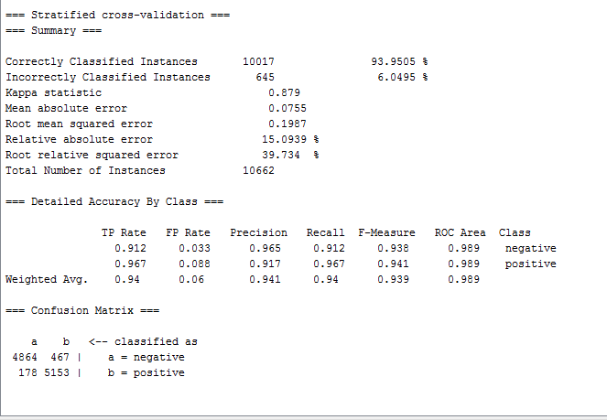
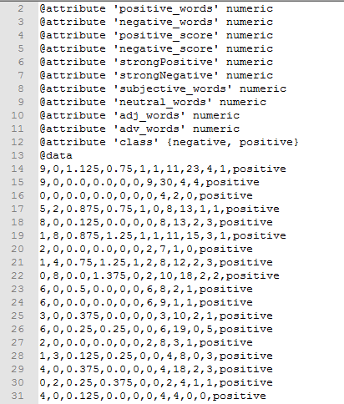
.arff file used by WEKA using J48 decision tree.

Slide 18
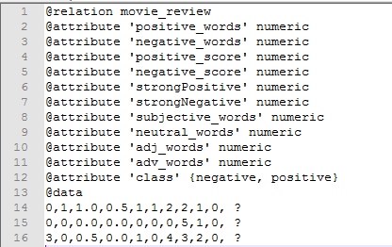
Prediction
WEKA model is saved, then used in java application along with WEKA jar to predict new reviews’ sentences classes
Review Example: “perfect movie no doubt. It has a great story and direction. good work for the whole crew.”
Output rate: 3.5 star
Prediction file

Slide 19
Used tools and technologies
Support victor machine (weka)
Android
MySql
Web server (tomcat 7, 8)
Stanford Parser
Stanford POS Tagger
Senti-wordnet
TMDb API

Slide 20
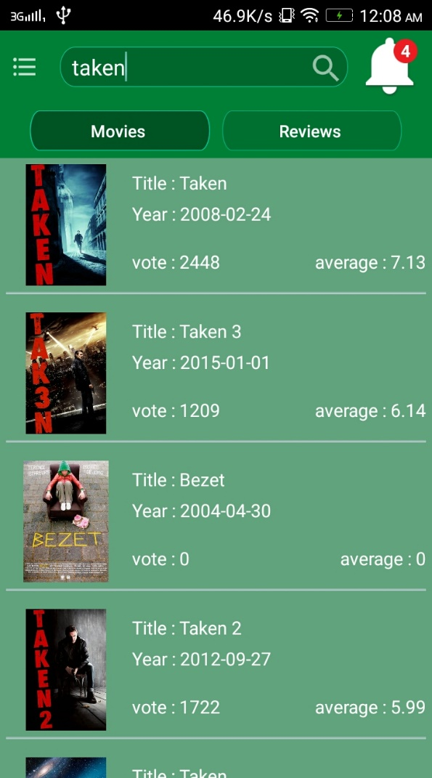

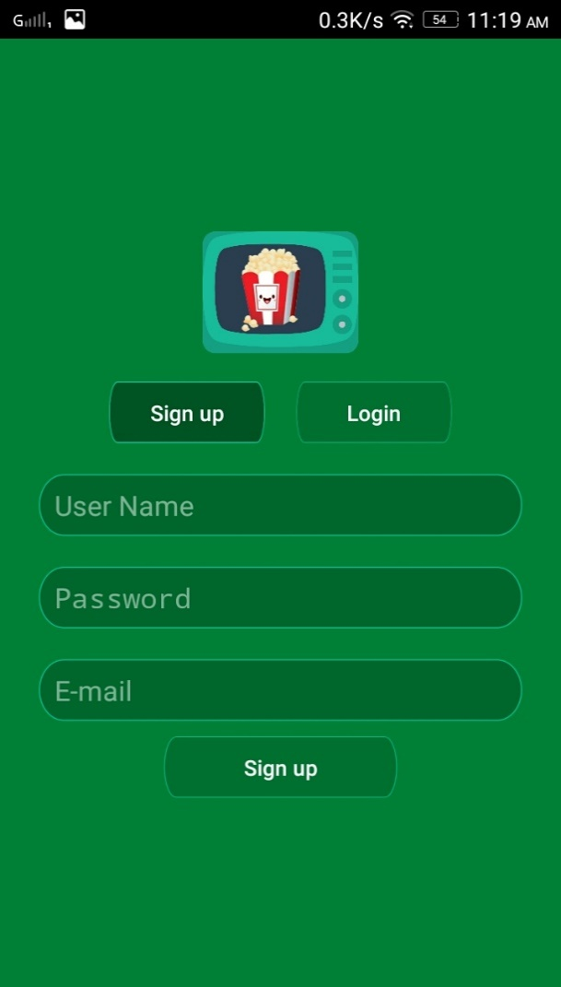
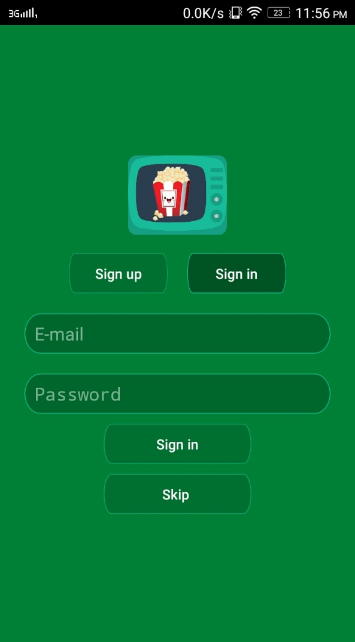
Application

Slide 21
Future Work
Removing features that has no effect on accuracy
Adding data to training data to get a better accuracy
Starting to use Arabic language in sentiment analysis in the application
Adding more sociable features for movie fans – watch together, watch later, know people with same taste in movies -

Slide 22
Conclusion
Watch and Rate provides:
Rating movie in a new way based on sentiment analysis
Ability to write and rate review
Show highest reviewers based on user score

